Slide 1

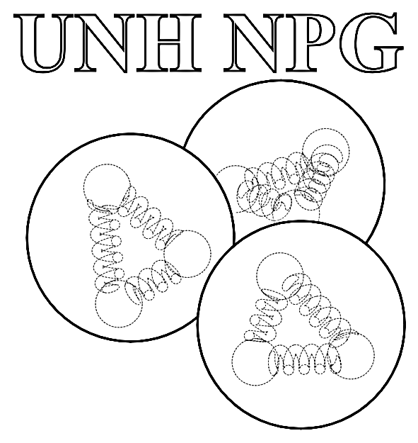
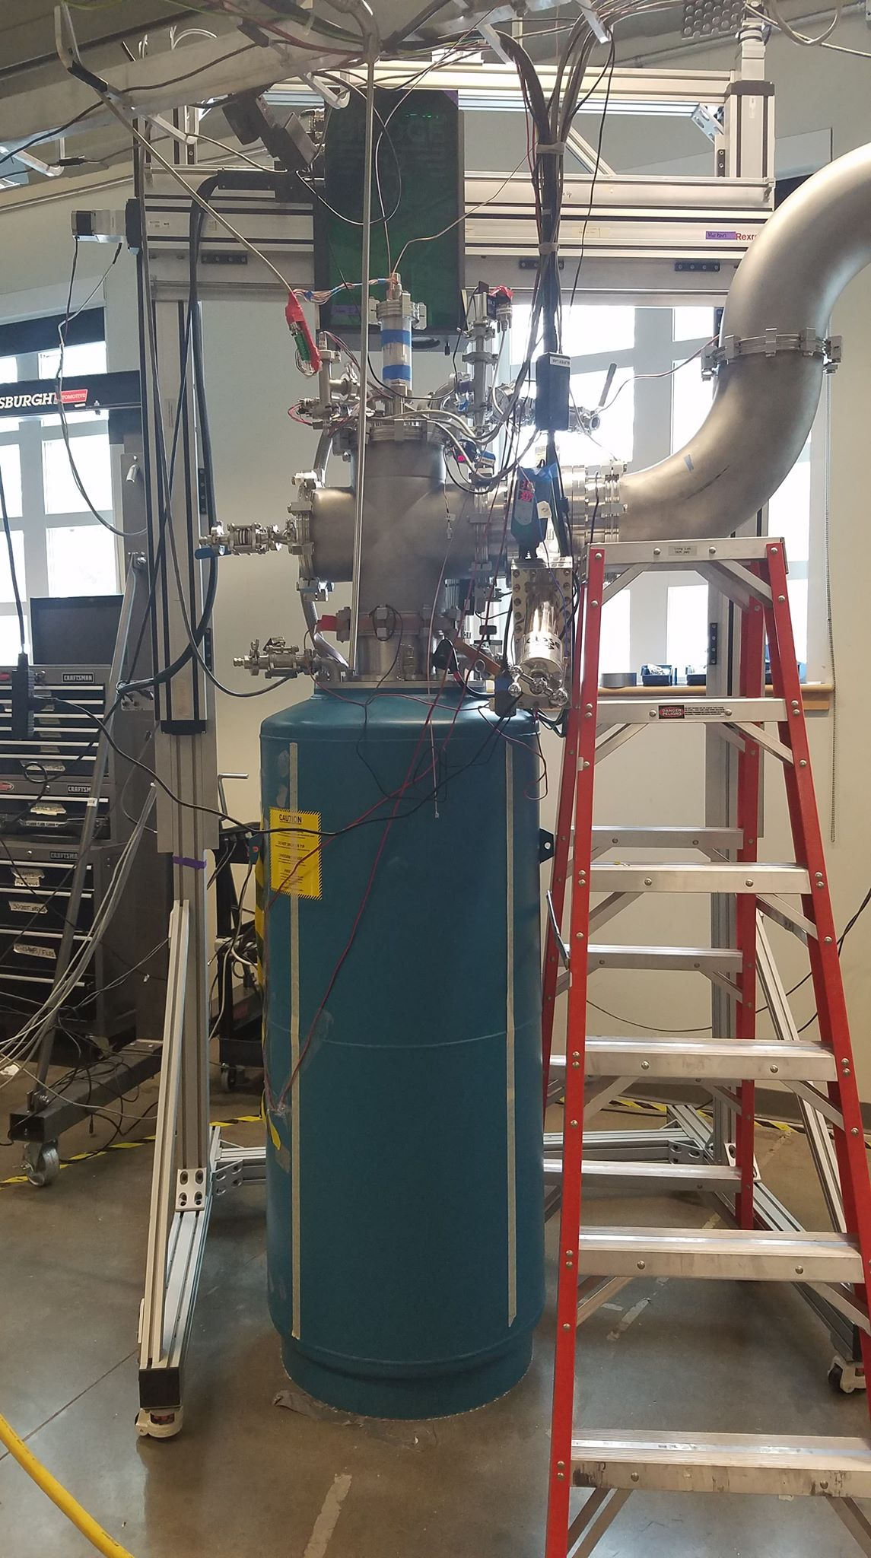
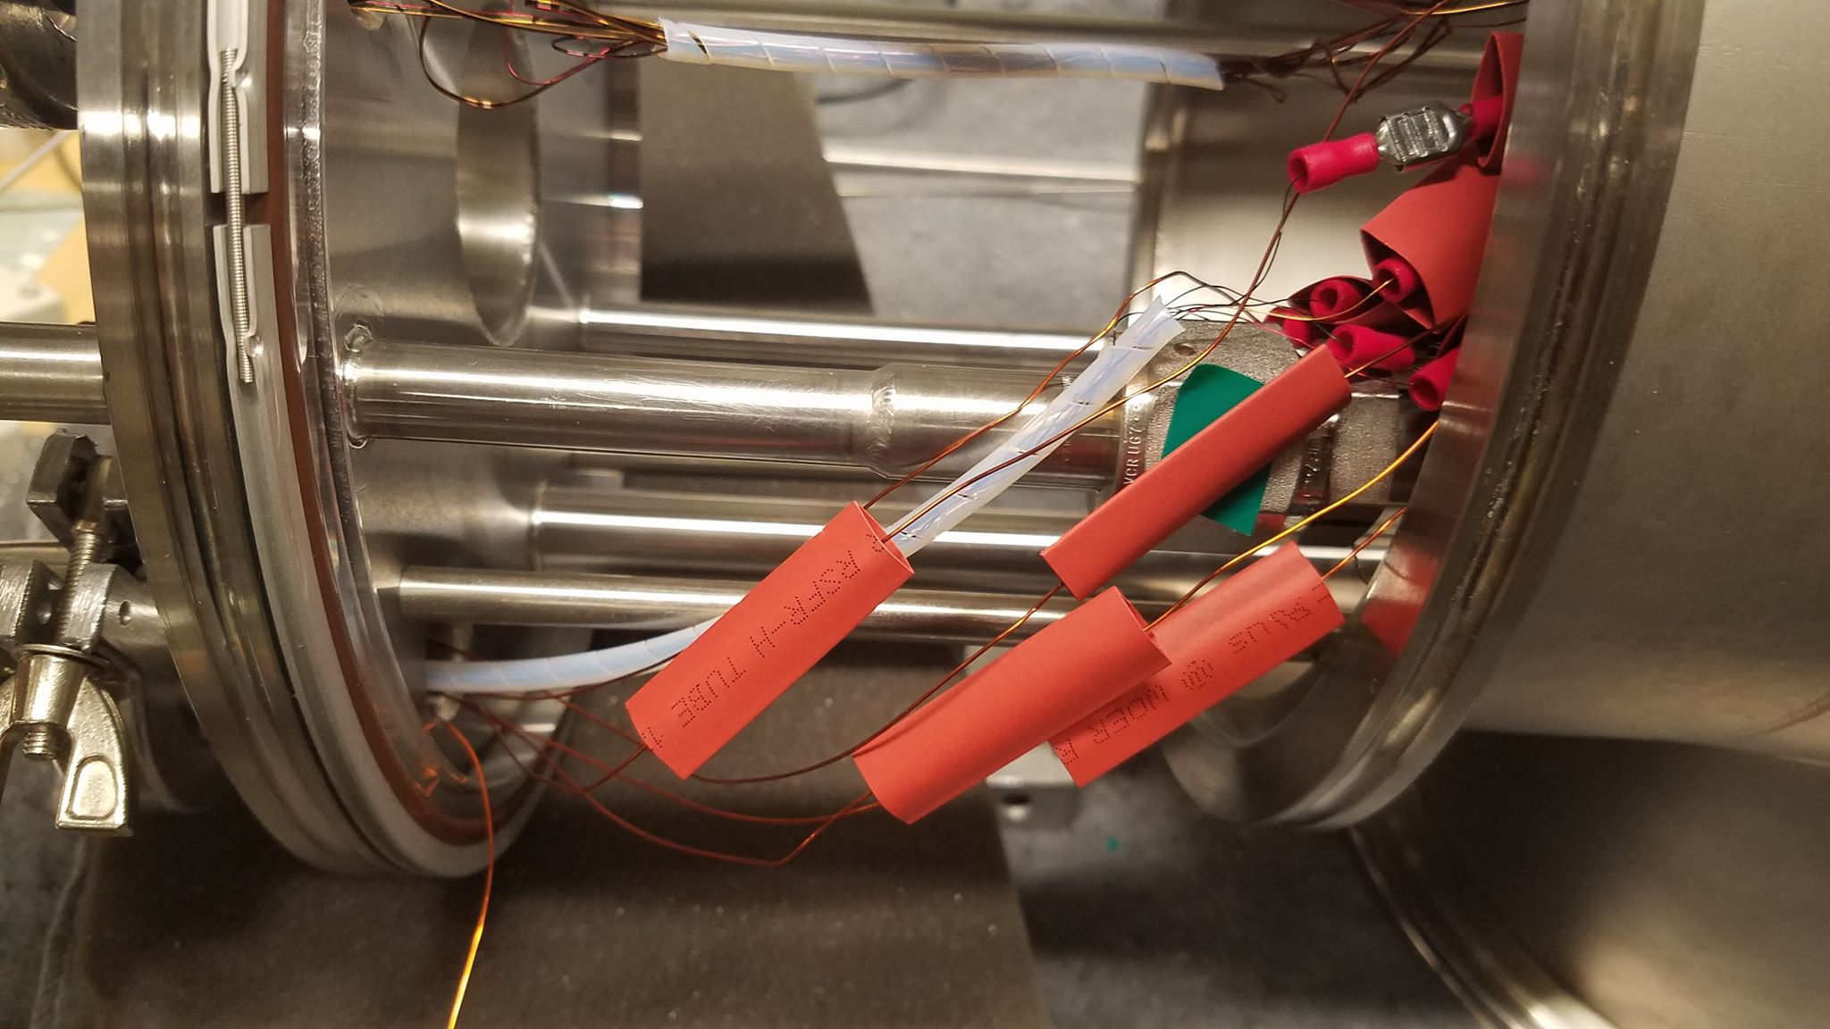
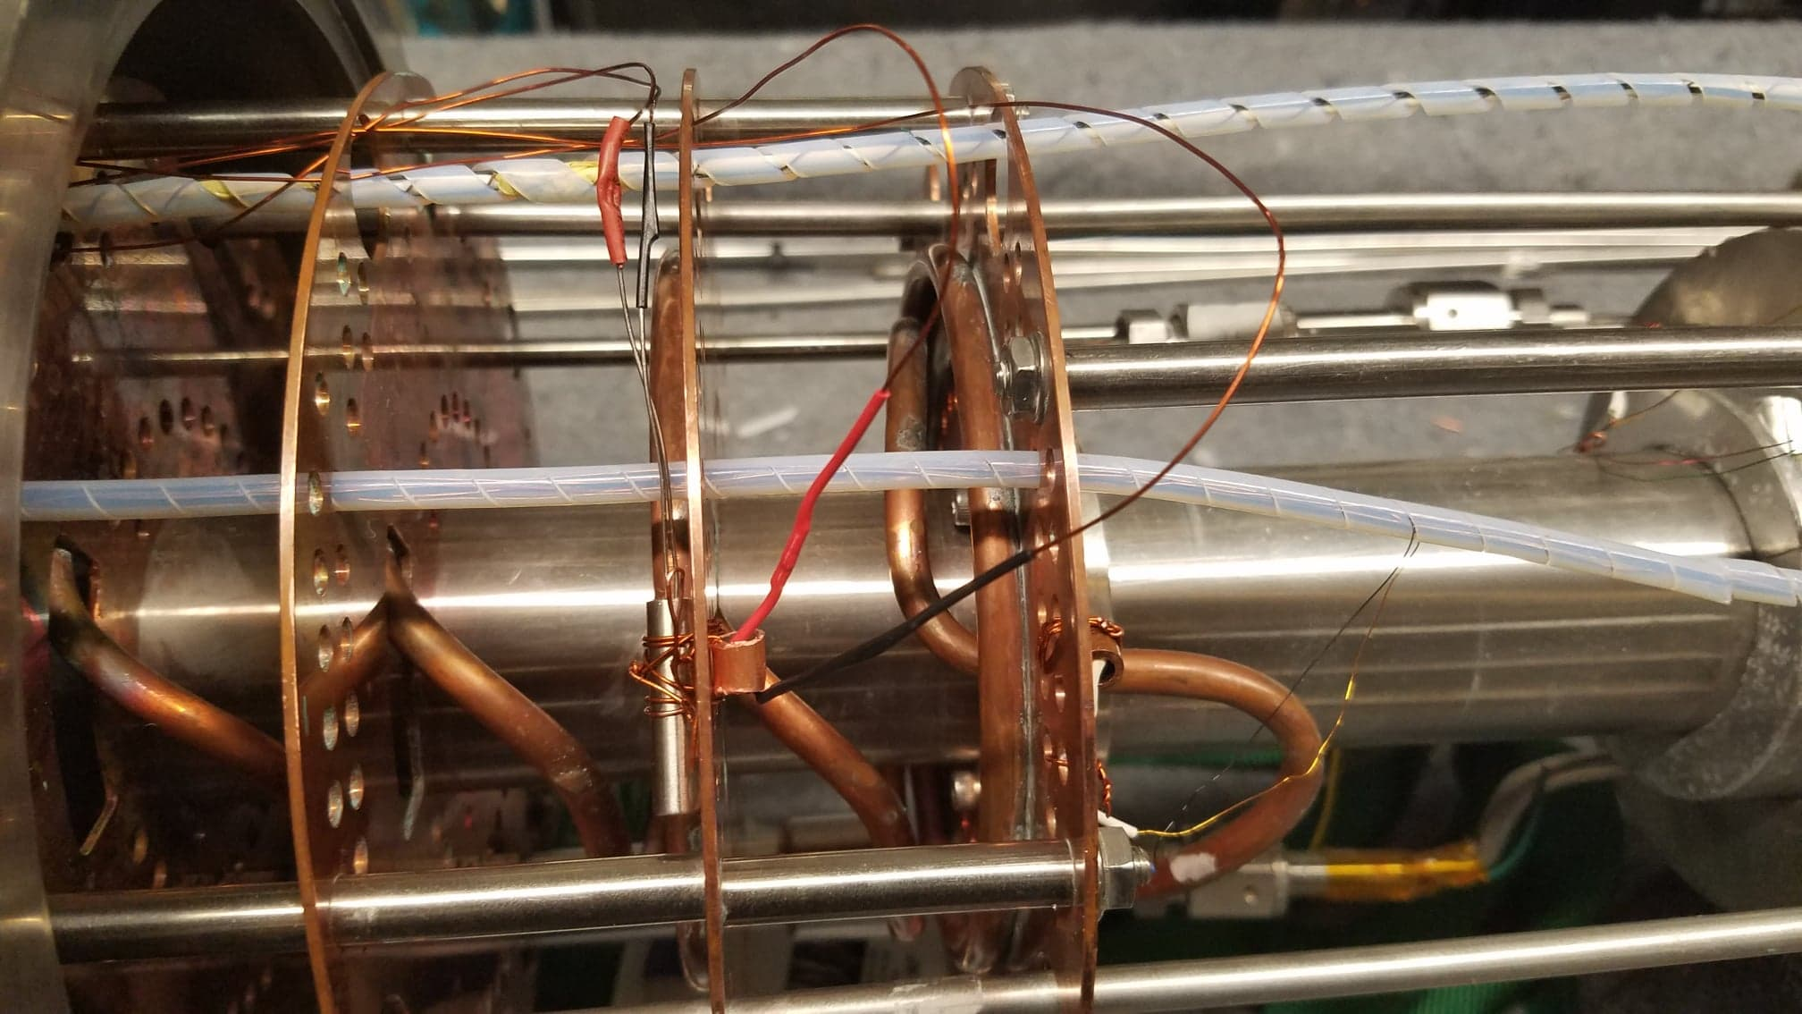
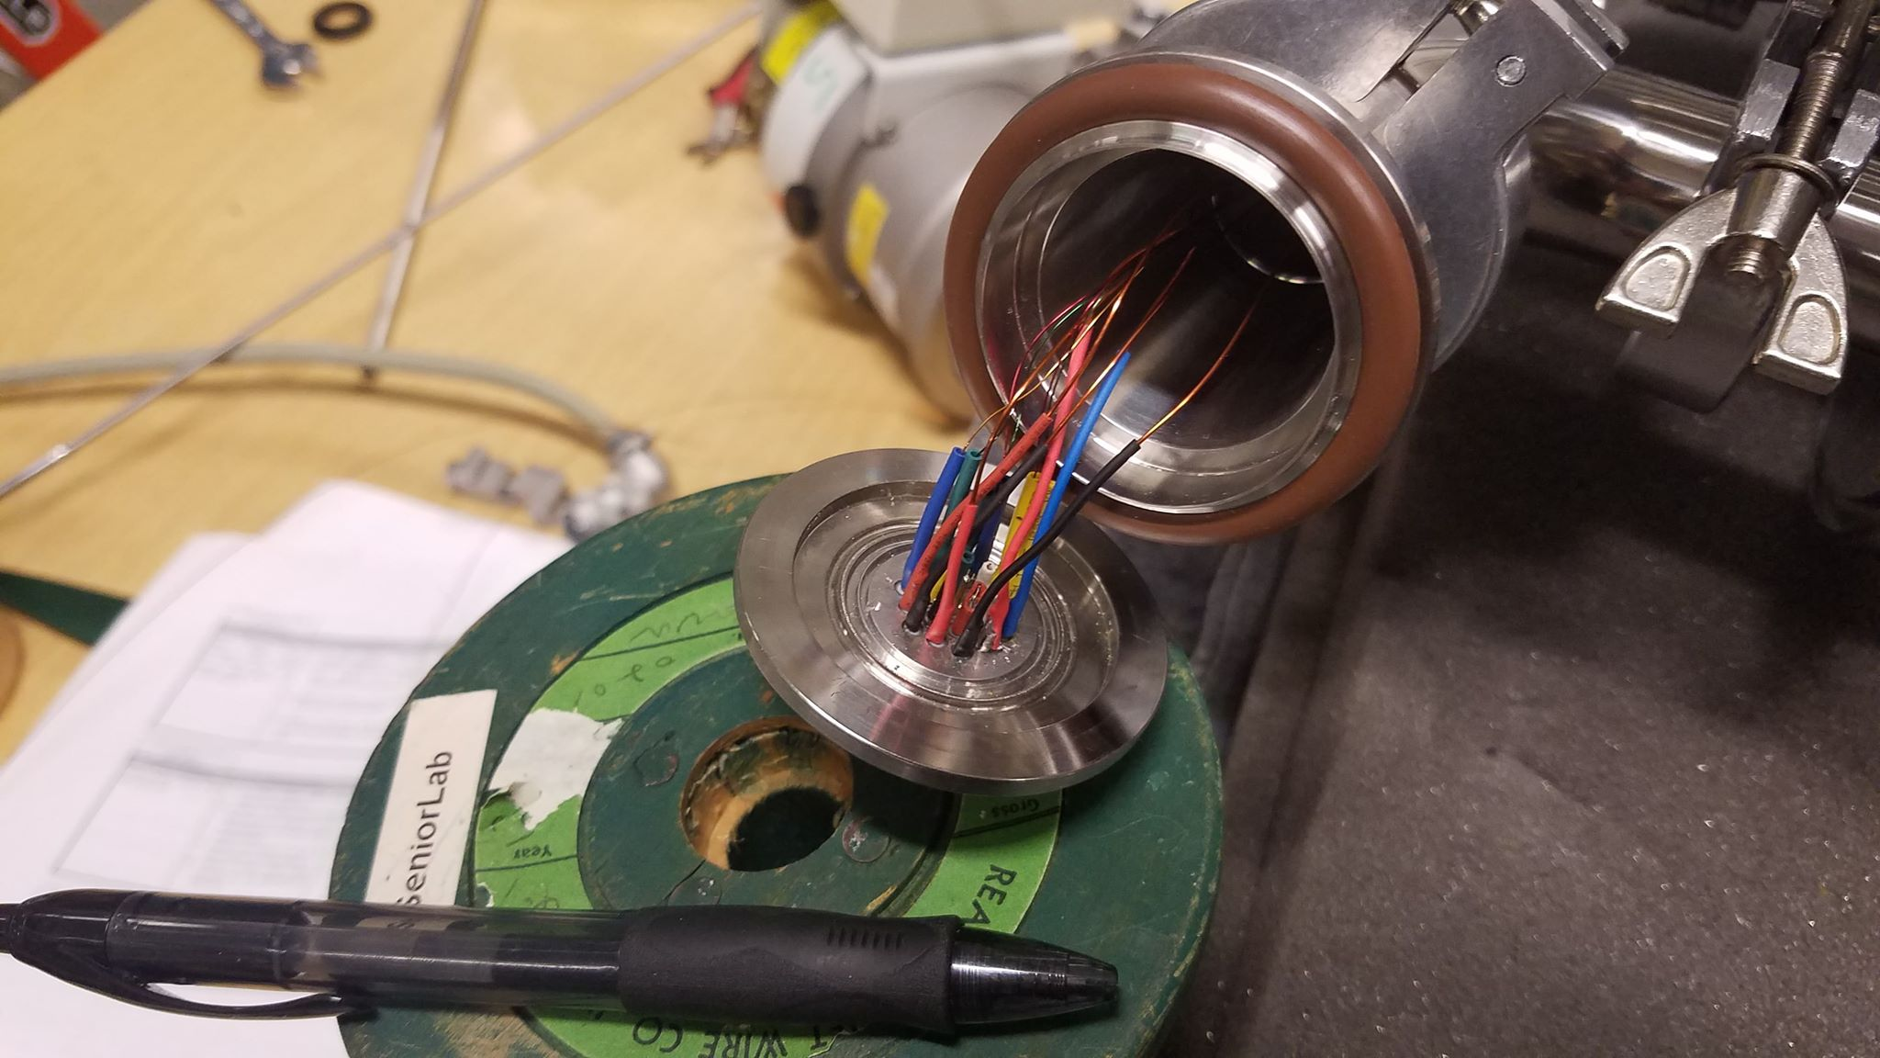
UNH NPG
Author: Thomas Collins
Advisor: Professor Karl Slifer
Mercury ITC
DB9 Pin Connection
19 Pin Connection
Spade clips?
Allen Bradly / Heating Cartridge

